Slide 1

DMD in Finance
TEAM 5

Slide 2

Team Members
Dinesh S
CB.EN.U4AIE19025
Sanjay B
CB.EN.U4AIE19056
Sarathi TS
CB.EN.U4AIE19058
Sivamaran
CB.EN.U4AIE19061

Slide 3

Table of contents
01
02
03
04
Introduction
Algorithm
A brief introduction about DMD
Algorithm of the DMD models
Implementation
Results & Observation
Implementation which is done in python
Results and its observation

Slide 4

01
INTRODUCTION

Slide 5
Dynamic Mode Decomposition [DMD]
Dynamic mode decomposition (DMD) is a data-driven dimensionality reduction algorithm developed by Peter Schmid in 2008
Given a time series of data, DMD computes a set of modes each of which is associated with a fixed oscillation frequency and decay/growth rate.

Slide 6
WORK FLOW
DMD on data of companies for same sector
DMD on data of companies for different sector
Making continuous prediction using DMD till the error threshold is reached
Comparison using ARIMA and DMD model
Error calculation is done using MAPE.

Slide 7
ARIMA and MAPE
An autoregressive integrated moving average, or ARIMA, is a statistical analysis model that uses time series data to either better understand the data set or to predict future trends. A statistical model is autoregressive if it predicts future values based on past values
MAPE
The mean absolute percentage error (MAPE) is the mean or average of the absolute percentage errors of forecasts. Error is defined as actual or observed value minus the forecasted value. Percentage errors are summed without regard to sign to compute MAPE

Slide 8

02
ALGORITHM

Slide 9
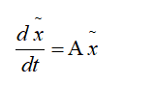
A dynamic system is described using a governing set of differential equations.
In DMD procedure, we construct an approximate linear evolution of the system.

Slide 10
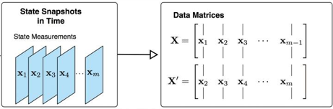
ALGORITHM

Slide 11
Step 1
We can truncate singular values to convert it into a low rank computation
Step2

Slide 12
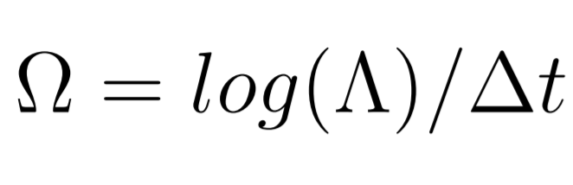
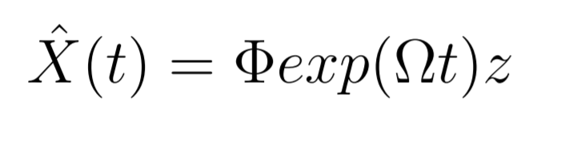
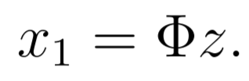
Step 3
Step 4
Reconstruction step

Slide 13

03
CODE IMPLEMENTATION

Slide 14
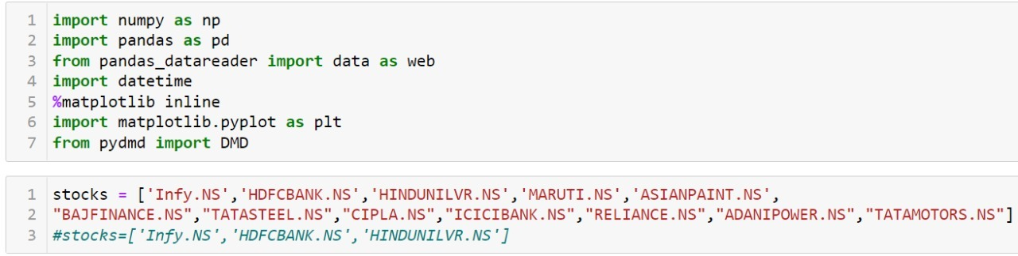
IMPORTING PACKAGES AND LOADING STOCK PRICES OF COMPANIES

Slide 15
CHOOSING STOCKS FROM SAME SECTOR

Slide 16
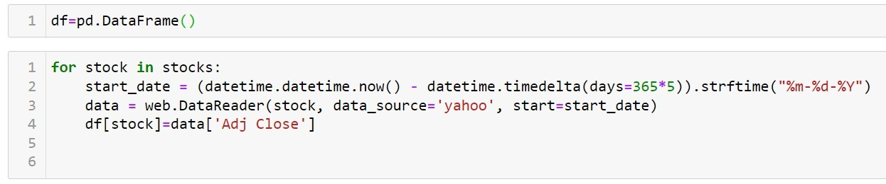
CREATING DATAFRAME FOR STOCKS

Slide 17
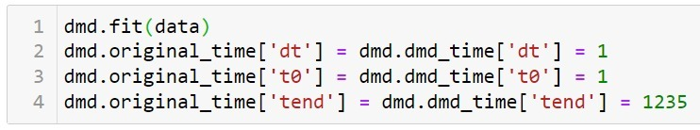
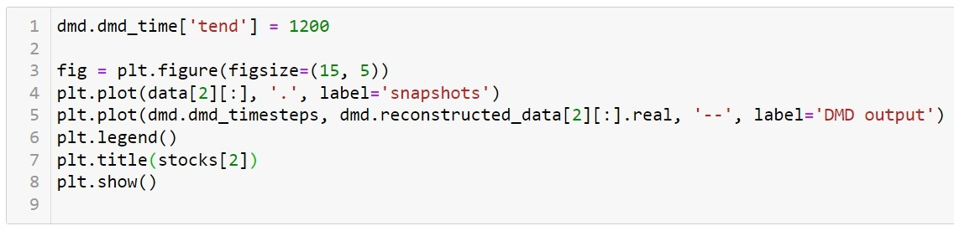
FITTING THE MODEL AND RECONSTRUCTION

Slide 18
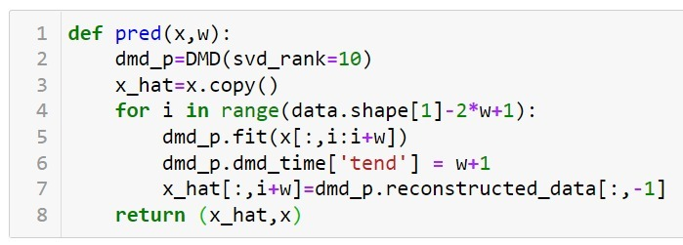
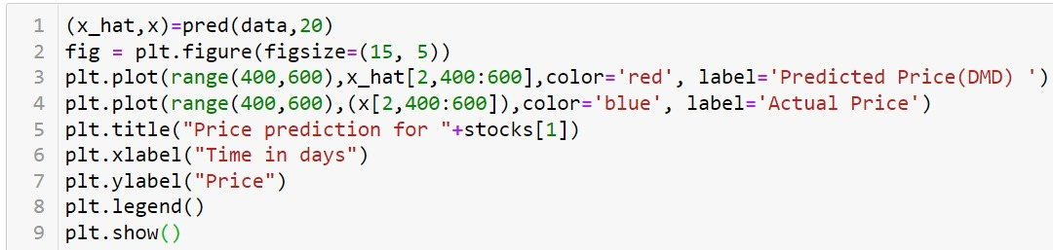
PREDICTING PRICES USING WINDOW SIZE

Slide 19
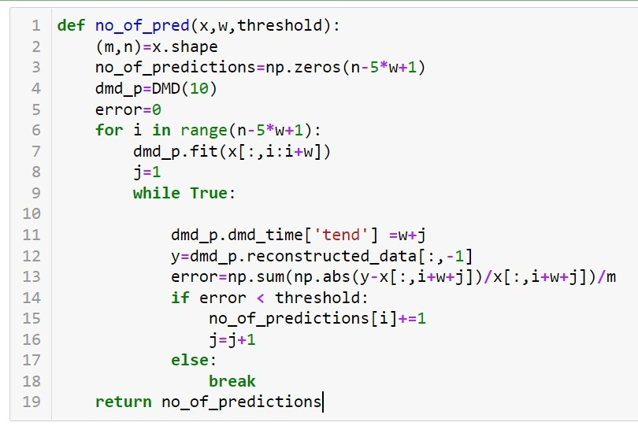
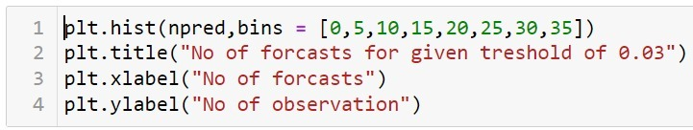
MAKING CONTINUOUS PREDICTIONS TILL THE THRESHOLD IS REACHED

Slide 20

RESULTS AND ANALYSIS
03

Slide 21
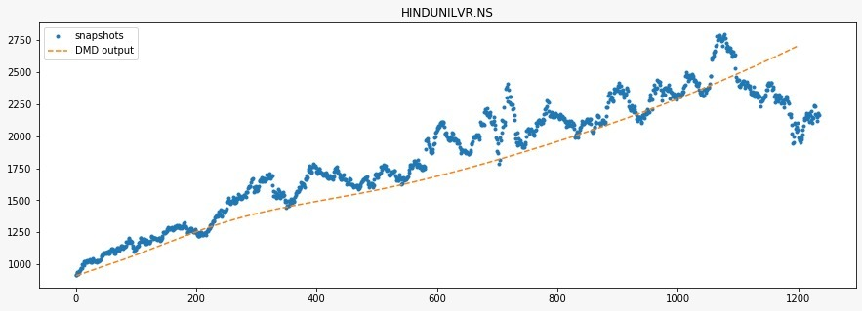
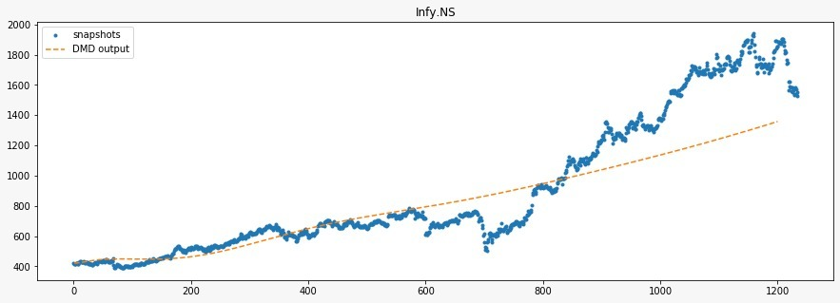
FITTING DMD MODEL FOR A DATASET

Slide 22
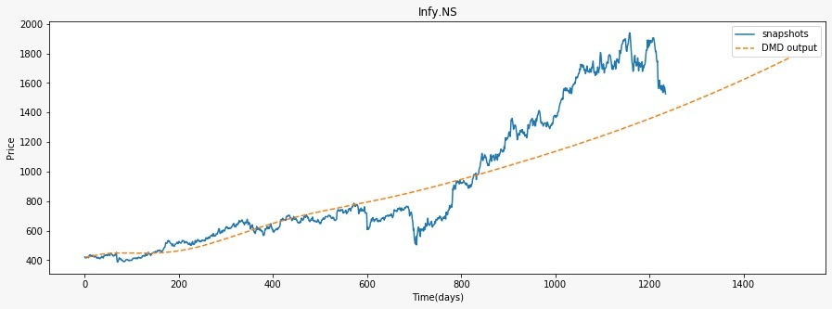
FORCASTING FUTURE VALUE USING DMD

Slide 23
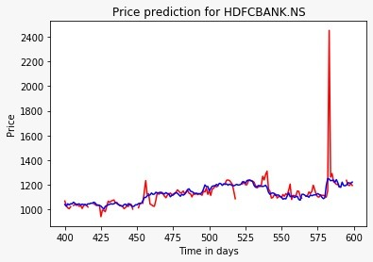
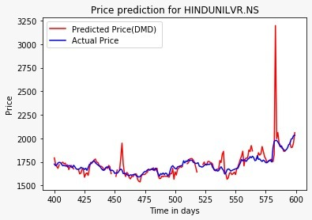
FITTING DMD WITH WINDOW SIZE
FOR STOCKS IN DIFFERENT SECTOR

Slide 24
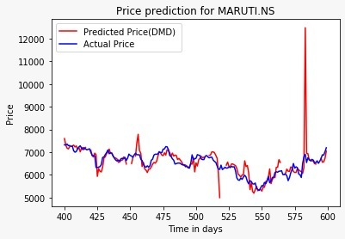
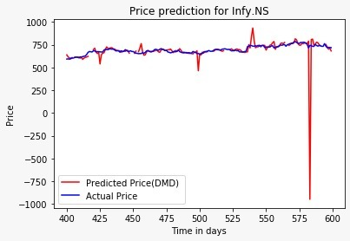

Slide 25
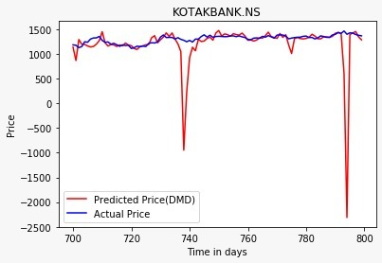
FITTING DMD WITH WINDOW SIZE
FOR STOCKS IN SAME SECTOR

Slide 26
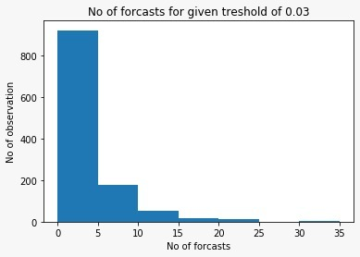
MAKING DMD PREDICTIONS FOR DIFFERENT SECTORS TILL THE THRESHOLD OF 0.03 IS CROSSED

Slide 27
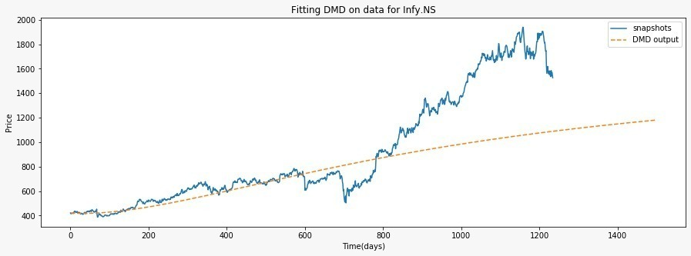
COMPARING FITTED MODEL FOR VARYING NUMBER OF COMPANIES

Slide 28
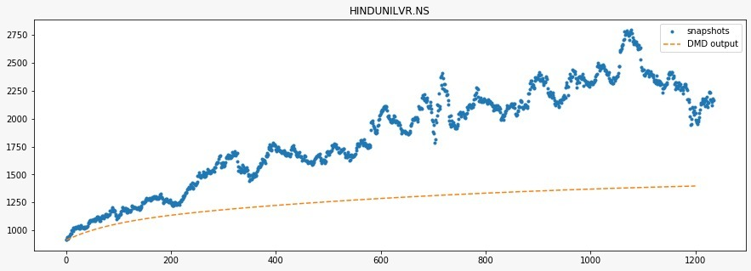
COMPARING FITTED MODEL FOR VARYING NUMBER OF COMPANIES

Slide 29
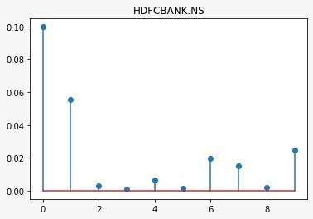
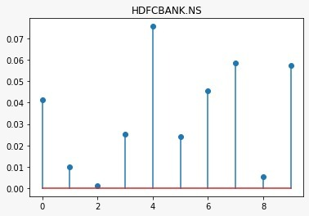
MAPE PLOT
DIFFFERENT SECTORS
SAME SECTOR
DIFFFERENT SECTORS VS SAME SECTOR

Slide 30
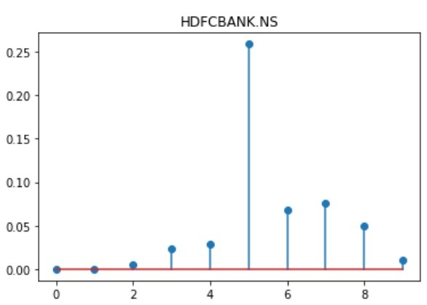
DIFFFERENT SECTORS WITH LESS NUMBER OF COMPANIES STOCK PRICES USED

Slide 31
COMPARISON OF ERROR RATE OF DMD AND ARIMA MODEL FOR SAME AND DIFFERENT SECTORS
 | DIFFERENT SECTORS | SAME SECTORS
DMD | 0.014 | 0.005
ARIMA | 0.034 | 0.01

Slide 32

Thank You !!!

